Slide 1

Business Analytics Capstone Framework for Strategy
Derek Catherine
December 12, 2023

Slide 2
Problem Statement

Slide 3
Problem Statement– Describe the Problem Adblockers present to GYF
The issue GYF is facing is adblockers preventing our ad-buying customers from being able to reach the potential customers they are looking to reach. If we do not do something about this, our ad-buying customers could potentially go somewhere else where there are no adblockers and cost us money

Slide 4
Problem Statement– Application Exercise 1 – Research Methods and Tools (Optional)
Given the definition of the problem GYF will face when it comes to adblockers, we’ll need to use descriptive research because we will need to find exactly how many of our customers will be affected by the potential of adblockers. We also need to find out how big of a hit our customers and we could potentially take financially due to the threat of adblockers.
Next, we will be using causal research by trying new ad appearances to see which one makes our customers more comfortable and to see which one our customers prefer to use. With this research, we will have a perfect understanding of which strategy we should use to approach this problem.
Research sources we will use are:
1.) Scanner data on the back end that will be able to track which users of our site have adblocker technology on and to also get a time stamp of when they are most likely to be using our site.
2.) Mobile surveys will be used to get the information we need from our users to see what will make them more comfortable on our site.
3.) Mobile data analytics will be used to tell us the number of users using adblockers when using our site and see how much they use the site on average
4.) Social media will be used to see how much users engage with our ads.

Slide 5
Strategy

Slide 6
Strategy Describe your proposed strategy
According to Google, an adblocker is a piece of software that is designed to prevent advertisements from being present on a web page. Our strategy will be to create a better advertising experience by showing users ads for items or activities that could be of interest to them based on information we collected about them from their social media pages. In order to do this, we will create a team whose sole responsibility is to focus on the individual users. We will also create a built in adblocker on our end to give users the choice to be able to see ads or not. This would be done because we can still see their cookies and see what links they click on during their time on our site which cannot be done if they are using their own adblocker. When this is complete, we will reach out to our users who have their own adblocker on to see if they would prefer their own adblocker or use ours and to consider by using their own, an unknown third party is keeping their data secure, which they may not be aware of.

Slide 7
Strategy Application Exercise 2 – Hiring a Team Leader (Optional)
We would also hire a team leader. After much consideration, we have decided to hire Carrie Candidate as Senior Associate Director of Digital Advertising Strategy. We know she is the best candidate for the job based on the scores on the work samples, cognitive ability tests, and structured interview we had each candidate complete, which Carrie got the highest scores on each.

Slide 8
Effects and Measurement

Slide 9
Effects Describe the anticipated effects of your strategy
Our strategy is to create a better advertising experience by showing users ads for items or activities that could be of interest to them based on information we collected about them from their social media pages. This will cause the user to see more ads for things that may interested them when it comes to things like sports, TV shows, restaurants, local things to do, etc. This most likely will cause the user’s engagement with the ads on our site to rise based on it striking their interest. This is a good way to bring in revenue for our company and also be beneficial to the customer because they may become loyal to a brand they would have never tried without seeing the ad on our site.

Slide 10
Measurement Describe the anticipated effects of your strategy and how you will measure them
Measurement of Performance of our Advertisements
• We will see how long users are on the advertiser’s web page after they click on the ad
• We can also measure the performance by
o Return on Investment metrics (Revenue – Cost of Goods sold)/Cost of Goods sold
o Brand Awareness which can be seen by how long the user visits the company’s webpage
o Click Thru Rate which will show how engaged the user was when they clicked on the ad

Slide 11
Effects Application Exercise 3 – Designing a Deterministic Optimization Model
In order to maximize the return in revenue (which is $42,824 after doing the math), the amount we spend on training in Hard Skills/Internal and Soft Skills/External should always be 0 so training does not need to be done in this areas. The company should still consider an expense of $26,765 on Soft Skills/Internal and $38,235 on Hard Skills/External training.
We must take into consideration that training programs are created by the human resources department so they may believe Hard Skills/Internal and Soft Skills/External training is necessary for employees to do their jobs right.

Slide 12
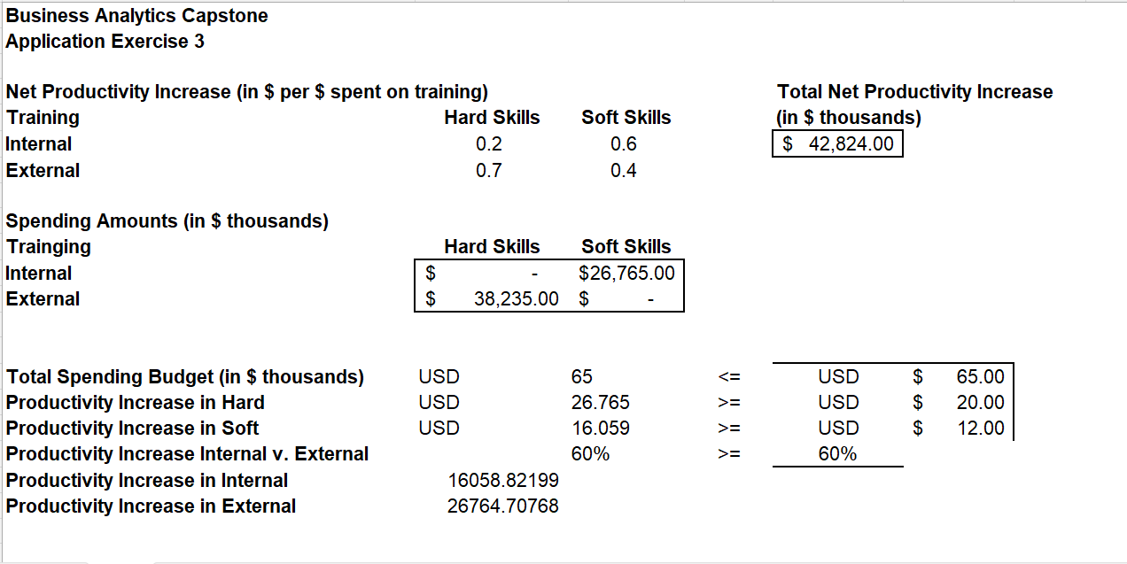
Measurement Application Exercise 4 – Identifying Key Drivers

Slide 13
Conclusion
Adblockers, as defined by Google, are a piece of software designed to prevent ads from popping up on a webpage. Advertisements on a web page are a way for the company running the webpage makes money and if adblockers are used by users of the web page, that is not good for the company.
Our strategy will be to create a better advertising experience by showing users ads for items or activities that could be of interest to them based on information we collected about them from their social media pages.
Our strategy will cause the user to see more ads for things that may interested them when it comes to things like sports, TV shows, restaurants, local things to do, etc. This most likely will cause the user’s engagement with the ads on our site to rise based on it striking their interest. This is a good way to bring in revenue for our company and also be beneficial to the customer because they may become loyal to a brand they would have never tried without seeing the ad on our site.

